Slide 1
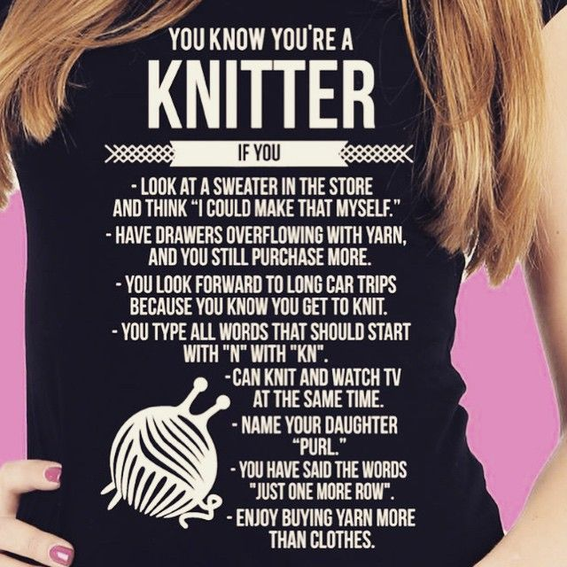
Yes, being a Knitwear Designer is cool!
The world of Knitwear Design
But it is also a lot more than that…
Image Source - https://www.pinterest.com/pin/500744052310003228/

Slide 2
Whats on Offer -
PG Level
The takeaways
Knitwear
Merchandising
An understanding of running the knitwear business

Slide 3
KD - IDM offered for PG
Knitwear Merchandising | Semester
Introduction to Knitwear Products | 1
Knitwear Appreciation | 2
Quality Management in Knitwear Industry | 3

Slide 4
Learning Outcome – PG IDM
Acquire the knowledge of Apparels and other Knitted products which can use knit fabric
Understanding of stretch fabric - Pattern Making, seams and machinery for production.
Knit fabric understanding – types / structures, GSM, Gauge, consumption, etc.
The student will be able to develop an effective cost and price planning for the Retail merchandise.
Understanding Parameters that define Quality of Knits for various categories

